Slide 1

EXPLORATORY DATA ANALYSIS CAPSTONE PROJECT – 01
World Bank Global Education Analysis
Project by Debartha Roy Chowdhury

Slide 2
Procedure
Data Understanding
Data Cleaning and wrangling
Data Visualization
Exploratory Data Analysis

Slide 3
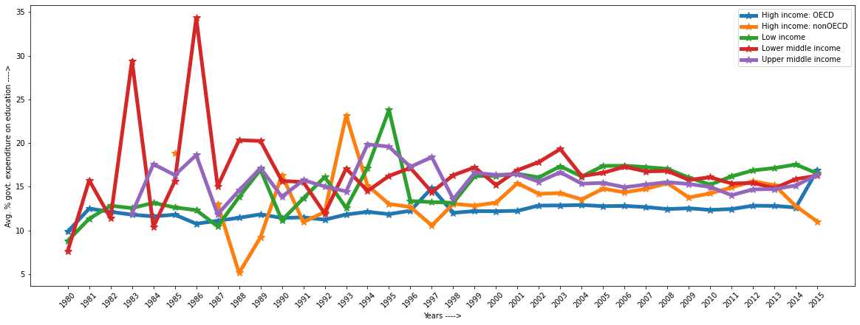
Observation: 1
Expenditure on education as percent of total government expenditure (%)

Slide 4
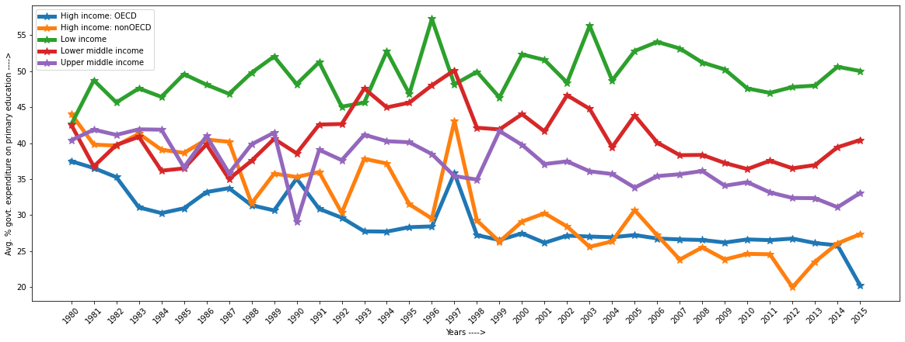
Observation: 2
Expenditure on primary as percent of government expenditure on education (%)

Slide 5
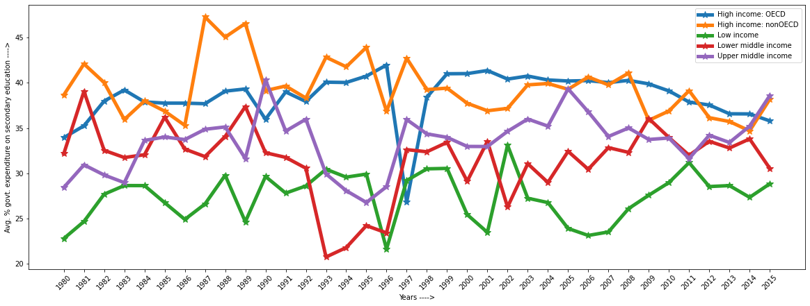
Observation: 3
Expenditure on secondary as percent of government expenditure on education (%)

Slide 6
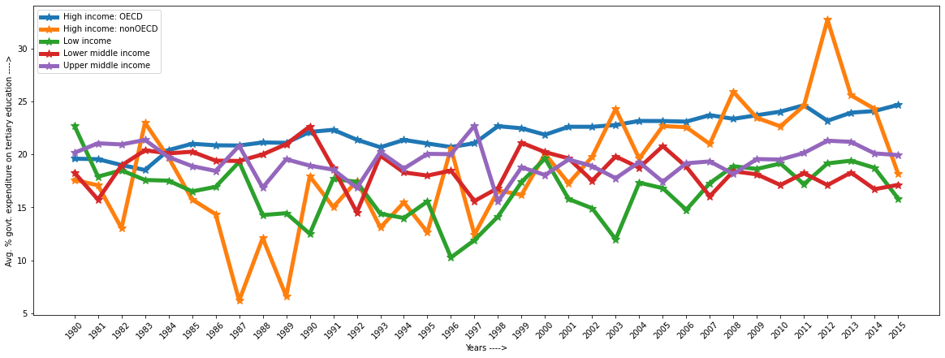
Observation: 4
Expenditure on tertiary as percent of government expenditure on education (%)

Slide 7
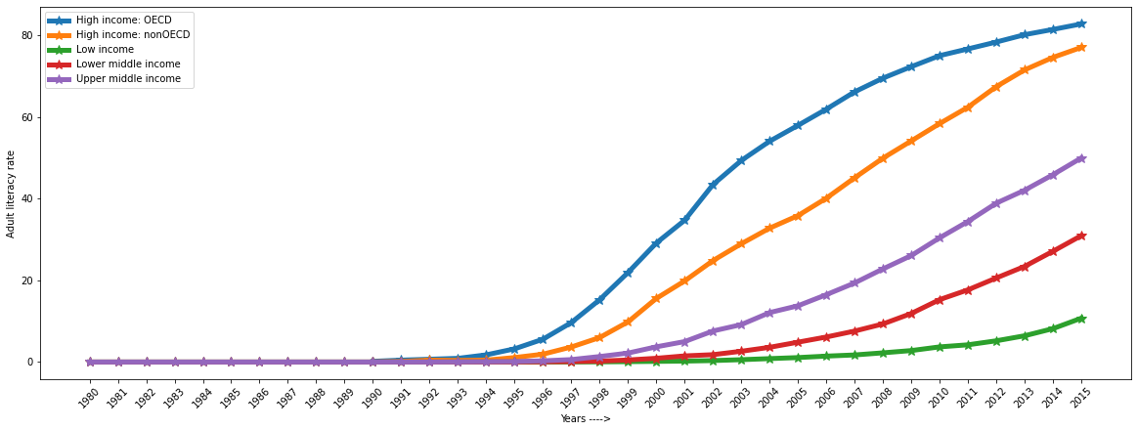
Observation: 5
Internet users (per 100 people) in the five income group

Slide 8
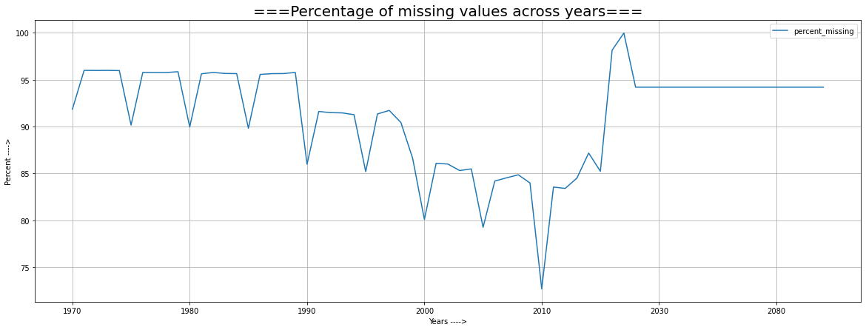
Observation: 6

Slide 9
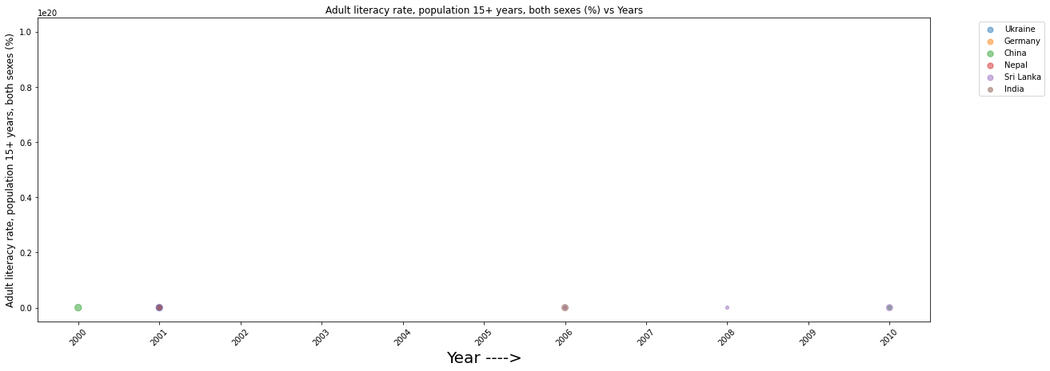
Observation: 7

Slide 10
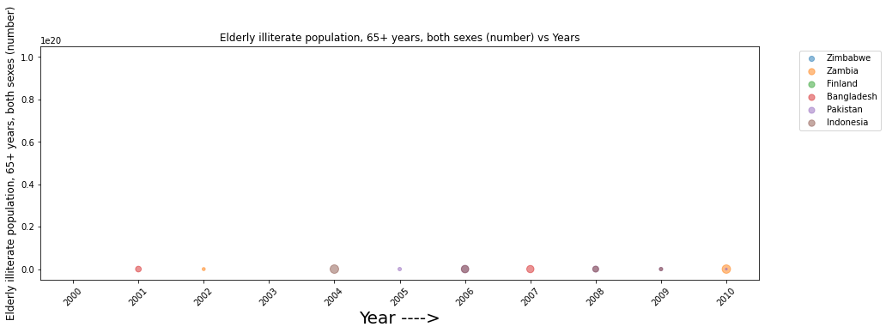
Observation: 8

Slide 11
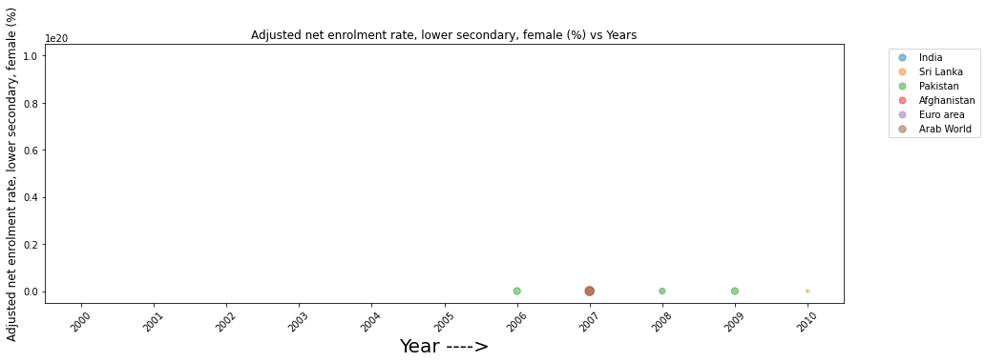
Observation: 9

Slide 12
CONCLUSION

Slide 13
THANK YOU!

